Slide 1
Usability Exam
Joydeep (MT2013062)

Slide 2
Domain of Interest
Health and fitness (Nike+ Running)
Android 4.4.4

Slide 3
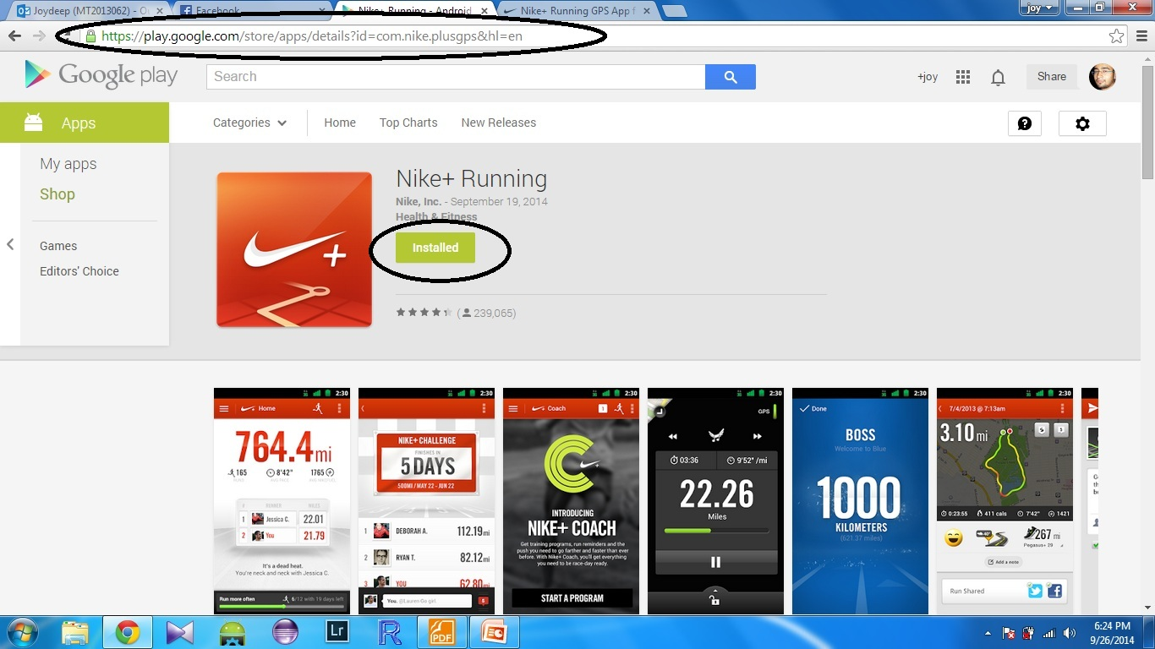
App chosen (Nike+ Running)

Slide 4
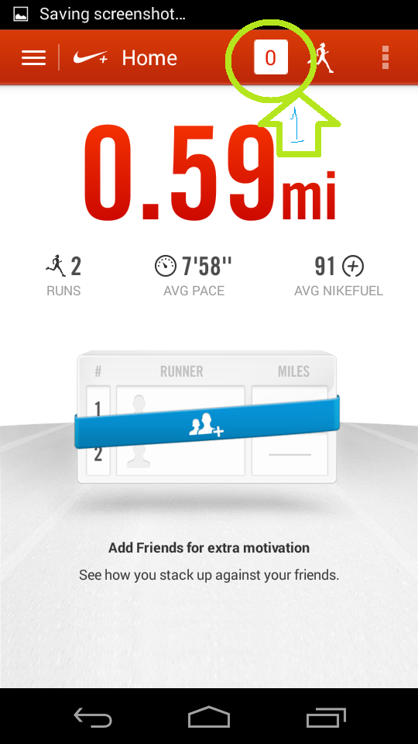
Usability principle violated
1. INCONSISTENCY
User will get more attracted to it and will get more hits.

Slide 5
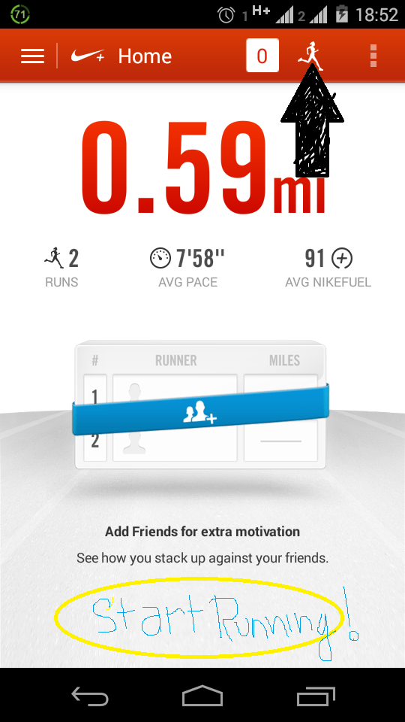
Usability principle violated
2. THE USER INTERFACE
Since this is a fitness app , you cant start the app and start measuring your work out unless you know that the app starts on the small run button on the top most bar.
The start button should be in between the body .

Slide 6
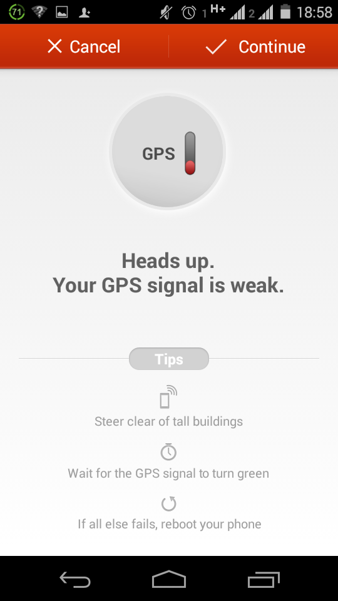
Usability principle violated
3.THE USER INTERFACE
This app shows weak signal even in iiitb parking area. Since this app was made to target urban areas, the developer should think of an alternative because its obvious that he will run on streets rather that an open ground.

Slide 7
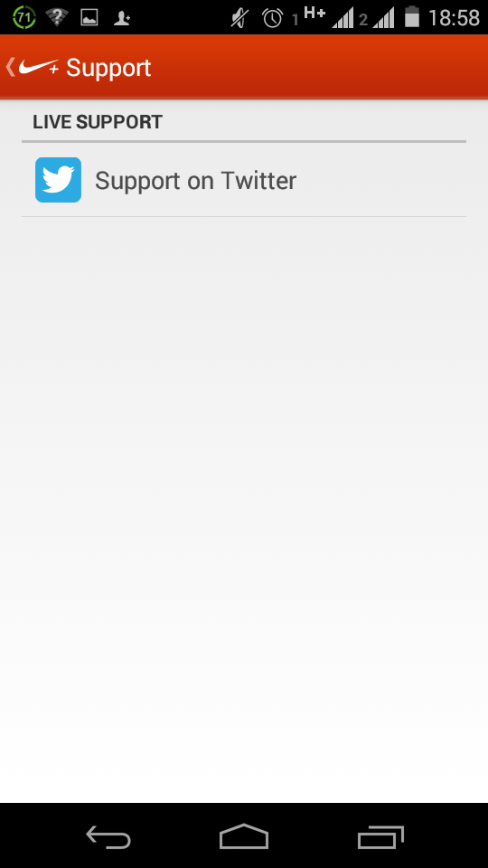
Usability principle violated
4 . THE USER INTERFACE
In setting you’ll support at the end after scrolling 20 odd menu’s.
Even after scrolling you’ll find support only for twitter user.
You are letting people add from facebook but you are not giving support to non twitter user.

Slide 8
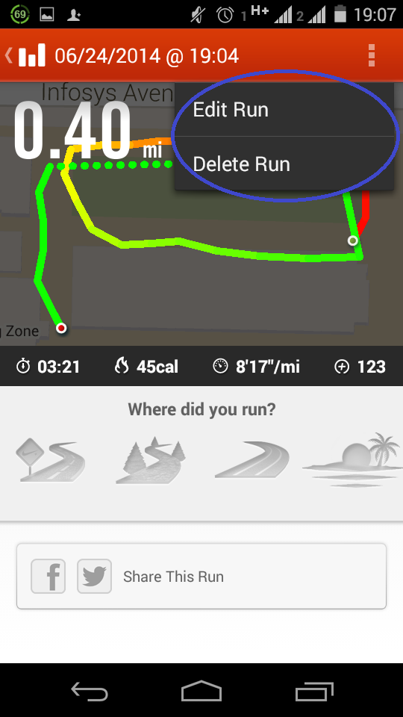
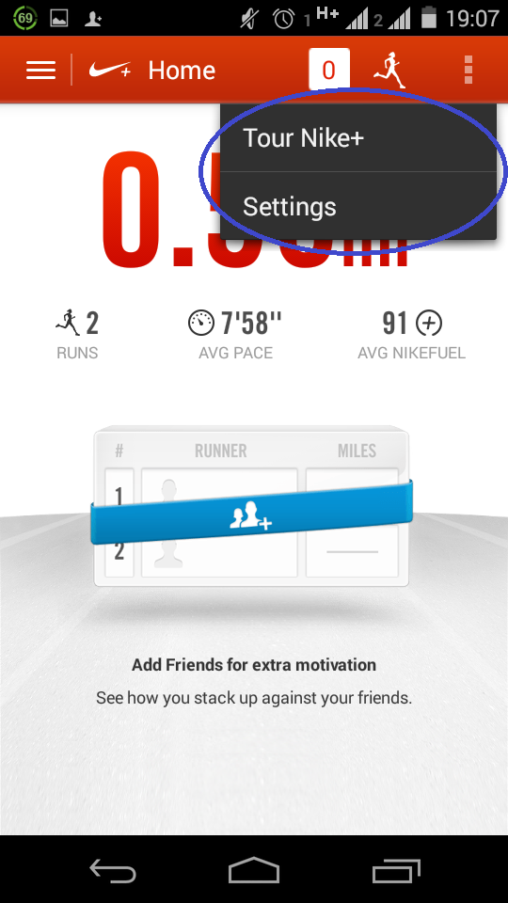
Usability principle violated
Menu are not unique
The user need to memorize what is where

Slide 9
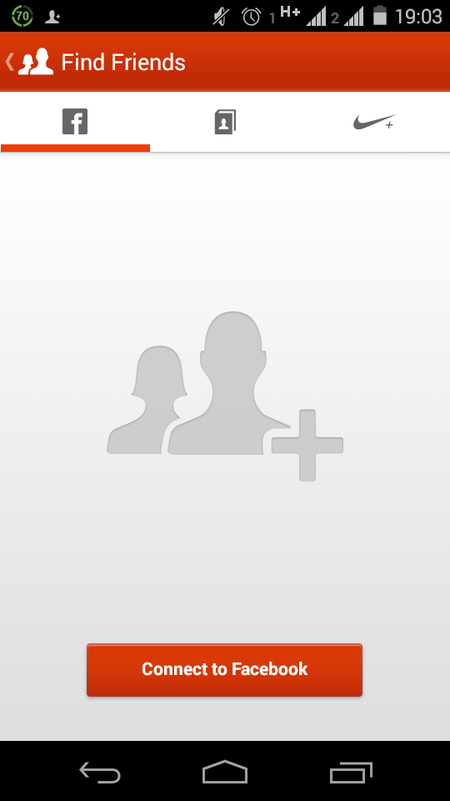
The app adheres to Usability principles
1. SUPPORTIVE
You can let people know about you fitness, the more you compete better will be you fitness.
You can add people from facebook, your contact list and nike+ runner users.

Slide 10
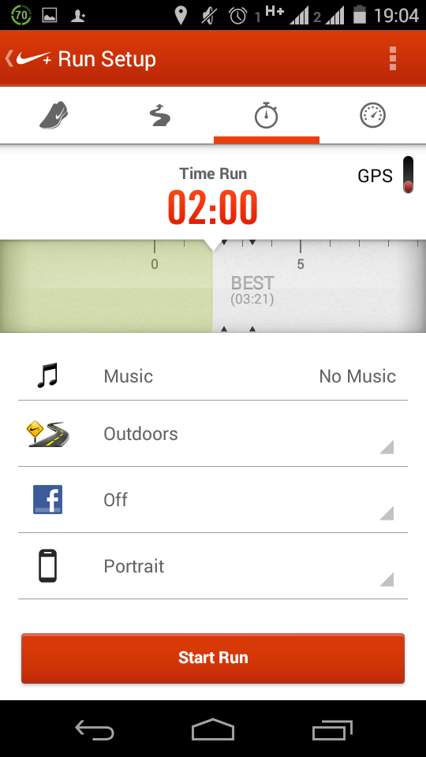
The app adheres to Usability principles
2. SUPPORTIVE
The user can set their favorite track while running. While running you need some music to keep yourself motivated.

Slide 11
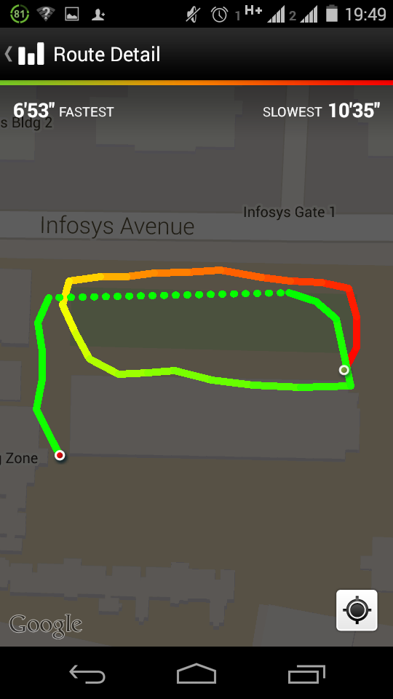
The app adheres to Usability principles
3. INFORMATIVE
It keeps track of entire details that are needed for this kind of app

Slide 12
Final verdict
Verified 5 usability flaws and 3 usability tested points.
If all the five usability issues gets resolved the app will be more usable.

Slide 13
Thank you!!

